Slide 1

Information Retrieval: History, Tasks and Challenges
Marina Litvak
SCE, Software Engineering dept., Israel

Slide 2

Agenda
Introduction into IR
IR main tasks
IR history
IR challenges:
preprocessing,
evaluation,
multilinguality

Slide 3
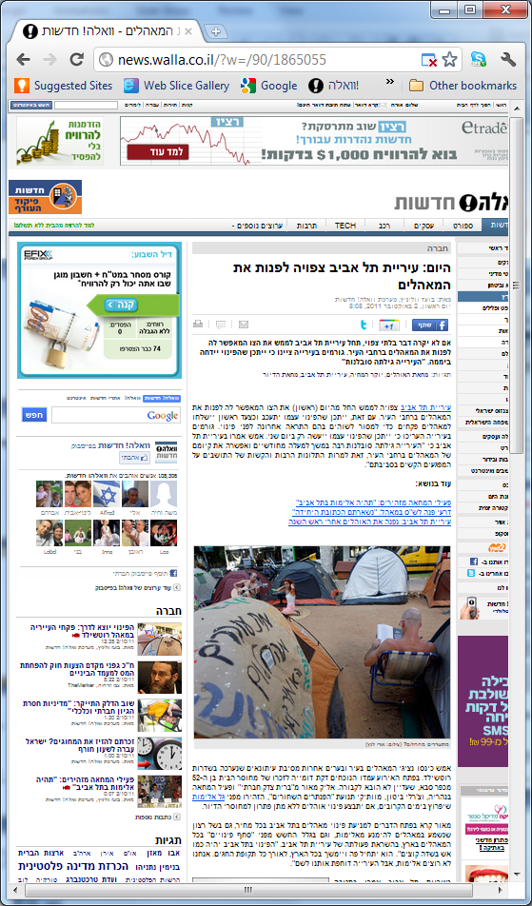
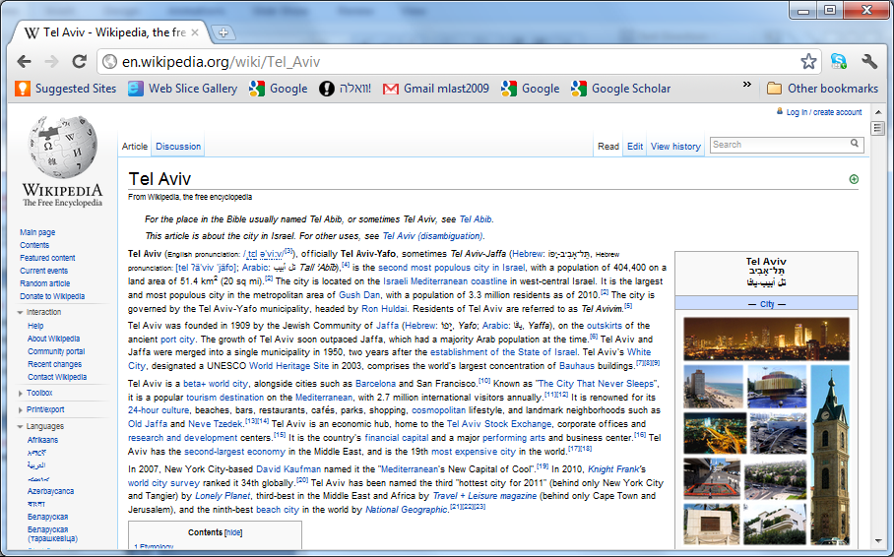

Too much to read…

Slide 4


Slide 5

Introduction into IR
Goal is to automatically discover and present knowledge–facts, rules, and relationships–that is hidden in textual content.
Notes:
(TA) is a very wide research area.
It’s overarching goal is to discover and present knowledge–facts, rules, and relationships–that is otherwise hidden in textual content and unattainable by automated processing.
Prior to applying analytical methods, text needs to be turned into structured data through the application of NLP.
Then, data mining techniques, including link and association analysis, visualization, and predictive analytics, can be applied to the structured input and used to produce a requested output.
Typical TA tasks include text categorization, text clustering, concept/entity extraction, production of granular taxonomies, sentiment analysis, document summarization, question answering, slot ﬁlling, and entity relation modeling.

Slide 6
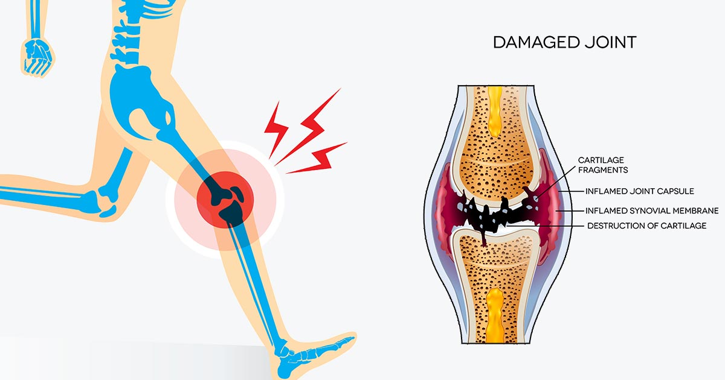






Introduction into IR, example
Knee pain:
Reason: sport, trauma, age, health problems?
Treatment: physiotherapy, rest, cold, heat, medications?
Information source: medical forums, articles, doctors, patients?
Restrictions: dance, ski, spinning, other activities?
Diet: exclude salt, add calcium?
Source of diet supplements: iHerb, Amazon, other?

Slide 7
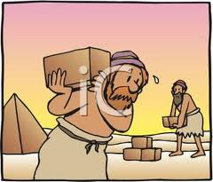
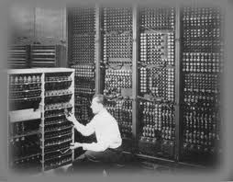





Information Retrieval
Employ humans
Use computers

Slide 8

Typical IR tasks, example
Search (documents retrieval),
Summarization,
Question answering,
Text categorization,
Text clustering,
Sentiment analysis,
Multilingual TA!

Slide 9
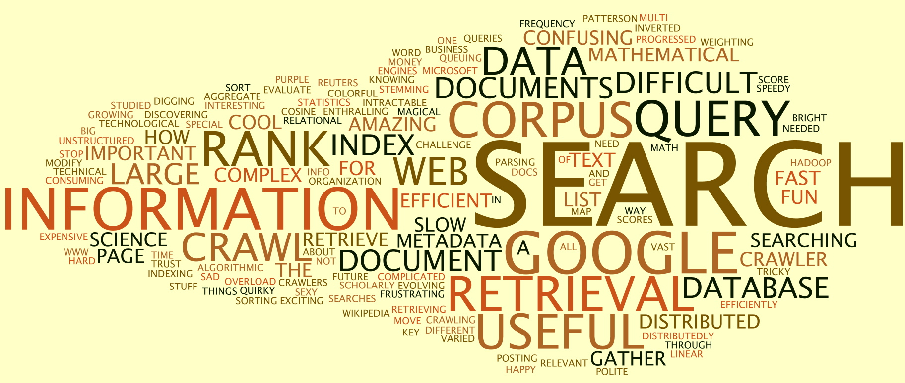
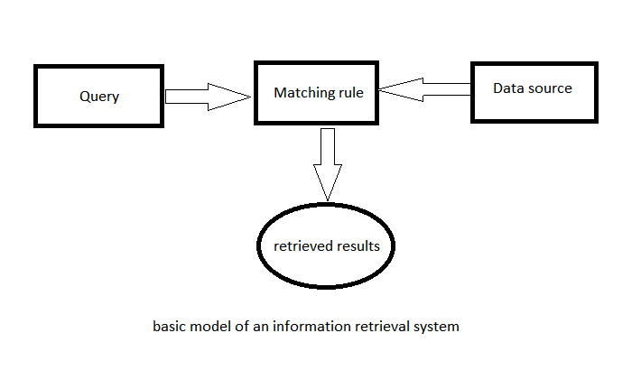
Search (information retrieval)
Automatic retrieval of electronic documents in a given corpus (WWW) that are relevant to a query

Slide 10




Search (information retrieval)
For a user – just using a search engine (query, logic operators)
For a developer:
Text preprocessing
Text representation (bag-of-words, VSM, as described in Natalia’s talk)
Text Indexing (inversed index, …)
Text storage (distributed)
Efficient retrieval (with map-reduce)
Advanced search (logic operators)
Evaluation
Recommended book:

Slide 11

Summarization☺
Summary - a comprehensive and usually brief abstract;
Summarize - to make a summary of;
Summary
must contain the most important information from a source document
information may be generic or query-based
Earthquake in Japan:
* Location
* Magnitude
* Victims
Earthquake in Japan:
* Location
* Magnitude
* Victims
Which countries provided humanitarian aid?
Which countries provided humanitarian aid?

Slide 12

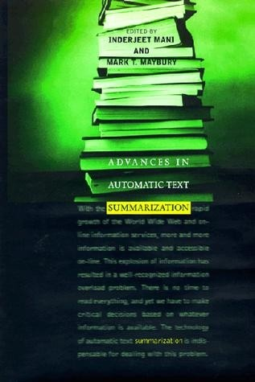
Summarization
For a user – using a summarizer (length constraints, input docs, query,..)
For a developer:
Text preprocessing
Representation model
Ranking/optimization model
Summary compilation
Evaluation
Recommended book:

Slide 13
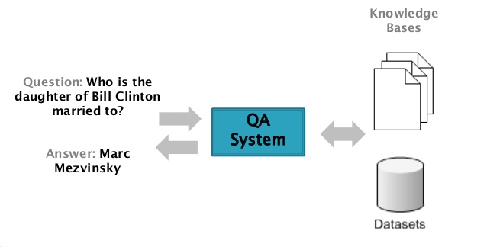
Question Answering

Slide 14
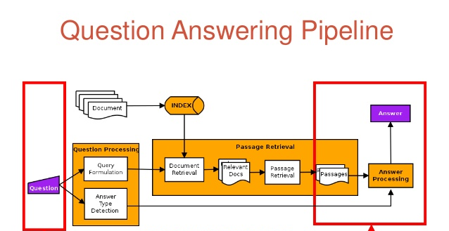
Question answering
Information Retrieval
Extractive Summarization
Clustering
Text Generation
Query Generation
Classification
“what is a treatment for a pain in a knee?”
“a cold compression and a bandage”
treatment AND pain AND knee
Documents retrieval -> extractive summarization -> clustering extracted parts -> answer generation

Slide 15

Question answering
For a user – submit a question in a forum
For a developer:
Text preprocessing
Representation model
Extracting/generating answers
Ranking answers
Unsupervised with relevance metric or
Supervised
Evaluation

Slide 16
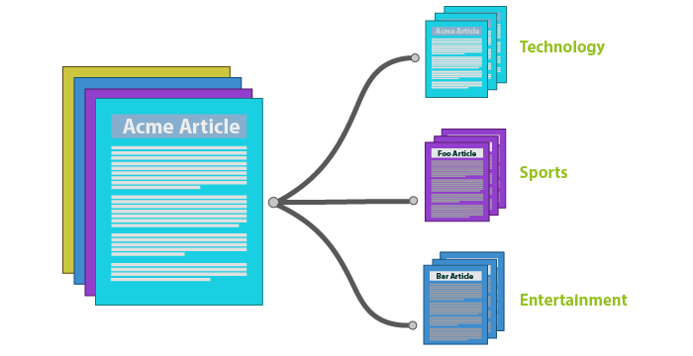
Text categorization/classification
Automatic assignment of a text to a predefined category/class

Slide 17
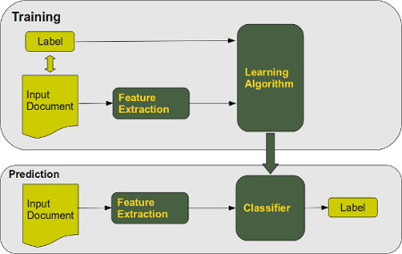
Text categorization: supervised learning
Manually assigned by a human expert
Set of rules: probabilistic or logic
Automatically assigned by the classifier

Slide 18






Text categorization
For a user – run a classifier (Weka, RapidMiner, KNIME, …)
Training – provide an annotated data
Classification – provide an input document
For a developer:
Text preprocessing (yes, again… we discuss it later)
Representation model
Classification model (DT, NB, Bayesian network, SVM, NN, …)
Evaluation (again!)
Deep Learning does not require feature engineering!

Slide 19
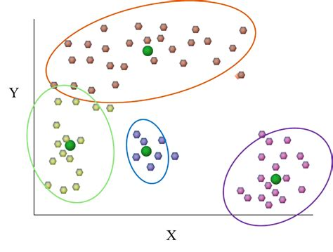
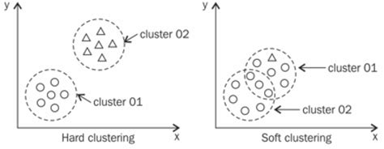
Text clustering
Automatic assignment of texts to groups (clusters)
Similar texts – same group
Different texts – different groups
Groups are NOT predefined
But the # sometimes needs to be specified
Can be soft or hard

Slide 20
Text clustering
For a user – run a clustering alg (Weka, RapidMiner, KNIME, …)
provide a set of documents
provide a number of clusters
No need in providing annotated data!!!
For a developer:
Text preprocessing
Representation model
Clustering method (K-means, hierarchical, graph partitioning, …)
Evaluation

Slide 21

Sentiment analysis
Automatic assignment of sentiment polarity to a given text
Positive, neutral, negative
Very useful in SM

Slide 22

Sentiment analysis
For a user – run a ML algorithm (Weka, RapidMiner, KNIME, …)
If it’s supervised, provide an annotated data
If it isn’t, provide heuristic rules
For a developer:
?
Representation model
Classification/clustering/statistical model
?
Deep learning arises!
Big data

Slide 23




Background
First TA works in the fourties:
Bush’s paper, 1945
Luhn‘s paper, 1957
Edmundson‘s paper, 1969
Two decades with little activity
Remarkable growth since the 1980s (information era)
Mutilinguality challenge in 2000s (globalization era)
“Спутник-1” – October, 1957
World war 2 is ended but the cold war just began in 1945
Sir Tim Berners-Lee invented the World Wide Web in 1989

Slide 24
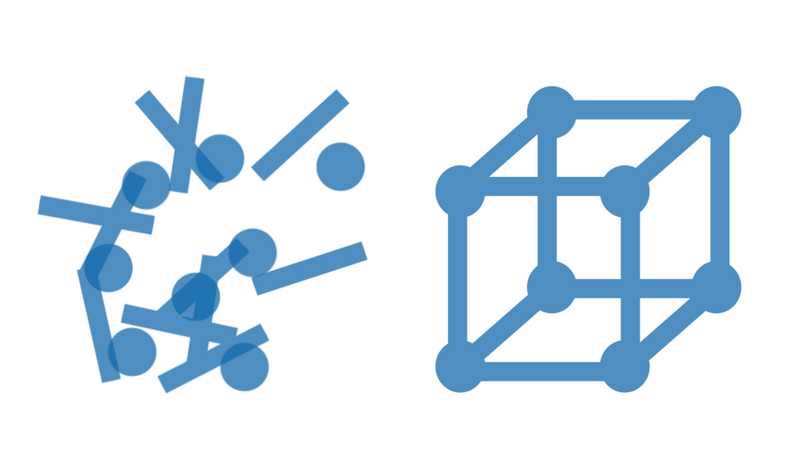
Text preprocessing
A text needs to be preprocessed before analysis
Sentence boundaries detection;
Word tokenization;
Stopwords removal;
…

Slide 25

Text preprocessing methods: Sentence boundaries detection (SBD)
First, text needs to be broken into basic, meaningful chunks.
Usually, it is a sentence, which is defined as “a set of words that is complete in itself, typically containing a subject and predicate, conveying a statement, question, exclamation, or command, and consisting of a main clause and sometimes one or more subordinate clauses.”

Slide 26
Text preprocessing methods: Sentence boundaries detection (SBD), an example

Slide 27


Text preprocessing methods: Sentence boundaries detection (SBD), a bad example
Prof. Lei Li from B.U.P.T. invited Dr. Natalia Vanetik and Dr. Marina Litvak to give a seminar in her class.
Prof. Lei Li from B.
U.P.T. invited Dr. Natalia Vanetik and Dr. Marina Litvak to give a seminar in her class.
Prof. Lei Li from B.U.P.T. invited Dr.
Natalia Vanetik and Dr. Marina Litvak to give a seminar in her class.
Prof. Lei Li from B.U.P.T. invited Dr. Natalia Vanetik and Dr. Marina Litvak to give a seminar in her class.

Slide 28

Text preprocessing methods: Word tokenization
Тhe process of breaking a character stream into strings, or tokens, that represent words
it is applied to a single sentence, after the SBD process has been completed

Slide 29
Text preprocessing methods: Word tokenization, example

Slide 30

Text preprocessing methods: Not as simple in all languages

Slide 31
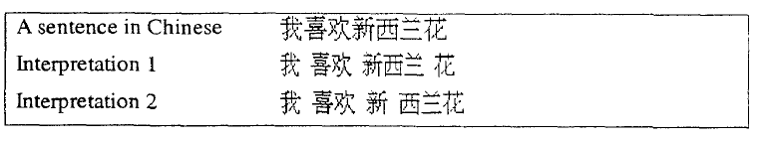
Text preprocessing methods: Word tokenization, example in Chinese

Slide 32
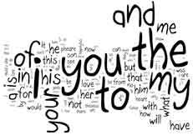
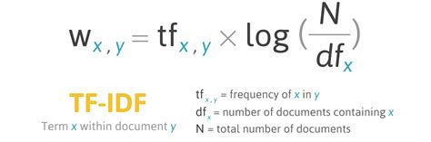
Text preprocessing methods: Stop-word removal
Stop words -- overly common words which do not identify important document parts.
Lists of stop-words are used
The lists are relatively small, and the cost of stop-word removal is not high.
Another strategy is to automatically filter out words with a low tf-idf score

Slide 33
Text preprocessing methods: Stop-word removal, exercise
Word w appears in 2 out of 4 documents and 3 times in a document d, which contains 9 words. Calculate tf-idf for w in d.
Word w appears in every document in a corpus. Which tf-idf score will it get? Will it be different for different documents?
Word w does not appear in d. Which tf-idf score will it get in d?
3/9*log(4/2) = ?
X*log(4/4) = ?
0/9*log(X) = ?

Slide 34
Text preprocessing methods: Stop-word removal, example
http://www.ranks.nl/stopwords

Slide 35
Text preprocessing methods: Stemming and lemmatization
Friend, friends, friendship, friendly – different forms of the same word
Need to be treated as ONE/SAME word
Stemming and lemmatization reduce a word variant to its
’stem’ in stemming (based on a set of rules) and
’lemma’ in lemmatization (based on the morphological analysis).
Notes:
Stemming is the process of reducing inflected words to their word stem, base,
or root form. The basic function of both stemming and lemmatization is similar.
Both of them reduce a word variant to its ’stem’ in stemming and to its ’lemma’ in
lemmatization.21 Stemming usually refers to a crude heuristic process that chops
off the ends of words in the hope of achieving this goal correctly most of the time,
and often includes the removal of derivational affixes. Lemmatization refers to
doing things properly with the use of a vocabulary and morphological analysis of
words; it normally aims to remove only the inflectional endings and to return the
base or dictionary form of a word, which is known as the lemma. If presented
with the token saw, stemming might return just s, whereas lemmatization would
attempt to return either see or saw depending on whether the use of the token
was as a verb or a noun.22 Based on described above, one may conclude that
using lemmatizer is preferable than using stemmer. However, stemmers are still
much more popular in NLP systems, because they require less knowledge than
lemmatizers, which need a complete vocabulary and morphological analysis to
correctly lemmatize words. Particular languages and domains may also require
special stemming rules. Nevertheless, the exact stemmed forms do not matter,
only the equivalence classes they form. Figure 3 gives an example of stemming
performed by Python NLTK23 using the Porter stemming algorithm.

Slide 36
Text preprocessing methods: Lemmatization
Lemmatization refers to doing things properly with the use of a vocabulary and morphological analysis of words;
it normally aims to remove only the inflectional endings and to return the base or dictionary form of a word, which is known as the lemma.
Notes:
Stemming is the process of reducing inflected words to their word stem, base,
or root form. The basic function of both stemming and lemmatization is similar.
Both of them reduce a word variant to its ’stem’ in stemming and to its ’lemma’ in
lemmatization.21 Stemming usually refers to a crude heuristic process that chops
off the ends of words in the hope of achieving this goal correctly most of the time,
and often includes the removal of derivational affixes. Lemmatization refers to
doing things properly with the use of a vocabulary and morphological analysis of
words; it normally aims to remove only the inflectional endings and to return the
base or dictionary form of a word, which is known as the lemma. If presented
with the token saw, stemming might return just s, whereas lemmatization would
attempt to return either see or saw depending on whether the use of the token
was as a verb or a noun.22 Based on described above, one may conclude that
using lemmatizer is preferable than using stemmer. However, stemmers are still
much more popular in NLP systems, because they require less knowledge than
lemmatizers, which need a complete vocabulary and morphological analysis to
correctly lemmatize words. Particular languages and domains may also require
special stemming rules. Nevertheless, the exact stemmed forms do not matter,
only the equivalence classes they form. Figure 3 gives an example of stemming
performed by Python NLTK23 using the Porter stemming algorithm.

Slide 37
Text preprocessing methods: Stemming vs. Lemmatization
Example:
“saw” “s”,
“saw” “see” (or “saw” if it is a noun)
Lemmatizer is more accurate than stemmer
Stemmers are still much more popular in NLP systems, because they require less knowledge
Particular languages may require special stemming rules.
stemming
lemmatization
Notes:
Stemming is the process of reducing inflected words to their word stem, base,
or root form. The basic function of both stemming and lemmatization is similar.
Both of them reduce a word variant to its ’stem’ in stemming and to its ’lemma’ in
lemmatization.21 Stemming usually refers to a crude heuristic process that chops
off the ends of words in the hope of achieving this goal correctly most of the time,
and often includes the removal of derivational affixes. Lemmatization refers to
doing things properly with the use of a vocabulary and morphological analysis of
words; it normally aims to remove only the inflectional endings and to return the
base or dictionary form of a word, which is known as the lemma. If presented
with the token saw, stemming might return just s, whereas lemmatization would
attempt to return either see or saw depending on whether the use of the token
was as a verb or a noun.22 Based on described above, one may conclude that
using lemmatizer is preferable than using stemmer. However, stemmers are still
much more popular in NLP systems, because they require less knowledge than
lemmatizers, which need a complete vocabulary and morphological analysis to
correctly lemmatize words. Particular languages and domains may also require
special stemming rules. Nevertheless, the exact stemmed forms do not matter,
only the equivalence classes they form. Figure 3 gives an example of stemming
performed by Python NLTK23 using the Porter stemming algorithm.

Slide 38
Text preprocessing methods: Stemming, example
Notes:
Nevertheless, the exact stemmed forms do not matter, only the equivalence classes they form. Figure 3 gives an example of stemming performed by Python NLTK23 using the Porter stemming algorithm.

Slide 39


Text preprocessing methods: Synonymization
A synonym is a word or phrase that means the same as another word or phrase in the same language.
Methods for synonym discovery range from automatic to list-based.
The automatic method relies on the expectation that similar words appear in a similar context.
List-based can use WordNet or a similar tool.
Notes:
People have a variety of ways to refer to the same real-world entity, forming different synonyms for the entity.
Formally, a synonym is a word or phrase that means exactly or nearly the same as another word or phrase in the same language.
Much research has been carried out on the search for similar words in corpora, mostly for applications in IR tasks. A large number of these approaches are based on the simple assumption that similar words are used in the same contexts.
Methods for synonym discovery range from automatic to listbased.
The automatic method relies on the expectation that similar words are
expected to have a similar context.

Slide 40
Text preprocessing methods: Synonymization, example
https://www.englisch-hilfen.de/en/words/synonyms.htm

Slide 41

Text preprocessing methods: Word-sense disambiguation (WSD)
The process of identifying the meanings of words in context.
“bass” – a type of fish or tones of low frequency?
“dog” – a pet or a sausage?
WordNet is a large lexical database of English.
Words are grouped into sets of cognitive synonyms (synsets), each expressing a distinct concept.
Notes:
The process of identifying the meanings of words in context.
A large number of the words in any given language carrying more than one meaning.
The correct sense of an ambiguous word can be selected based on its context.
The problem of WSD is defined as the task of automatically assigning the most appropriate meaning to a polysemous word within a given context.
“bass” - a type of fish or tones of low frequency? and its correct sense has to be determined from the context. WordNet is a large lexical database of English.
Nouns, verbs, adjectives and adverbs are grouped into sets of cognitive synonyms (synsets), each expressing a distinct concept. Synsets are interlinked by means of conceptual-semantic and lexical relations. The resulting network of meaningfully related words and concepts can be navigated with the browser.

Slide 42
Text preprocessing: Word-sense disambiguation, example
http://wordnetweb.princeton.edu/perl/webwn

Slide 43
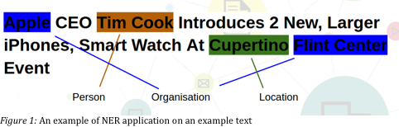

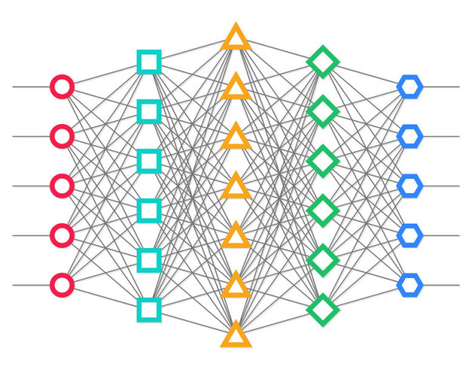
Text preprocessing methods: Named entity recognition (NER)
NER seeks to locate and classify named entities in text into predefined categories such as the
names of persons,
organizations,
locations,
expressions of times,
quantities, etc.
handcrafted rules -> supervised learning

Slide 44
Text preprocessing methods: NER, example
http://corenlp.run/

Slide 45
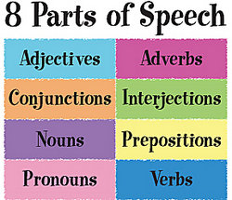
Text preprocessing methods: POS tagging
The annotation of words with the appropriate POS tags based on the context in which they appear.
Tags for POS divide words into categories based on the role they play in the sentence in which they appear.
The most common set of tags contains 7 different tags:
article,
noun,
verb,
adjective,
preposition,
number, and
pronoun.
Notes:
The annotation of words with the appropriate part-of-speech tags based on the context in which they appear.
Tags for POS divide words into categories based on the role they play in the sentence in which they appear. These POS tags provide information about the semantic content of a word.
Most POS tag sets make use of the same basic categories. The most common set of tags contains seven different tags (article, noun, verb, adjective, preposition, number, and pronoun).

Slide 46
Text preprocessing methods: POS tagging, example
http://corenlp.run/

Slide 47

Evaluation of TA tasks
Intrinsic evaluation is the direct comparison of the generated results against gold standard (human-generated) data.
Extrinsic evaluation is the indirect examination from the perspective of system’s effects on the performance of another task.
Automatic is performed by calculating quality metrics.
Manual is performed by using human judgments.
Notes:
Can be divided to intrinsic and extrinsic.
Intrinsic evaluation is the direct comparison of the generated results against gold standard (human-generated with purpose of training and/or evaluation) data.
Extrinsic evaluation is the indirect examination from the perspective of system’s effects on the performance of another task.
Both can be performed automatically–by calculating quality metrics–or manually–using human judgments.
Each approach has its own advantages and drawbacks. The cheapest method in terms of time and resources is automatic intrinsic evaluation, where scores for standard metrics measuring matching between gold standard and generated output are calculated and reported.

Slide 48

Evaluation of TA tasks: Automatic evaluation, metrics
The most frequently used metrics are:
True/False Positive/Negative (TP, FP, TN, FN),
Precision (P),
Recall (R),
F-measure,
Accuracy,
Area Under Curve (AUC), and
Perplexity (for evaluating probability models).

Slide 49
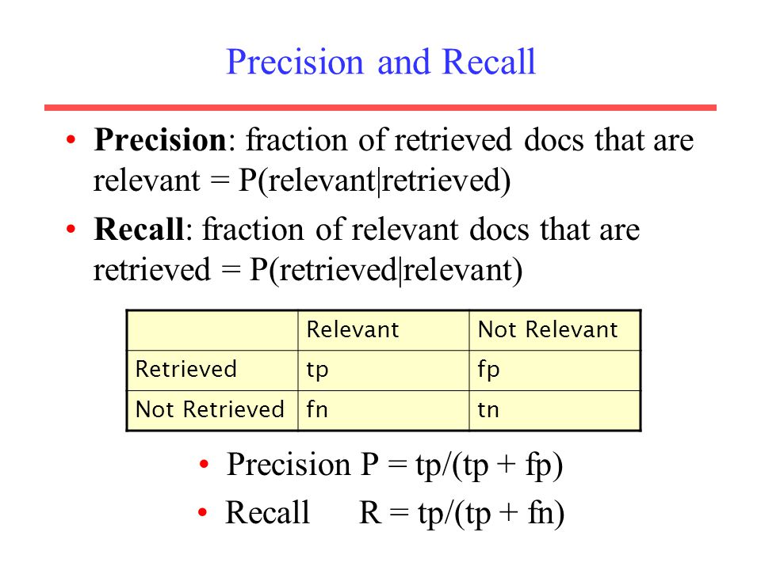
Evaluation of TA tasks:

Slide 50
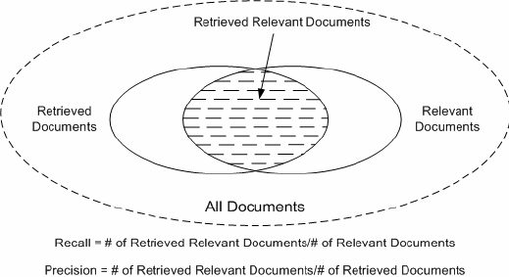
Evaluation metrics, exercise
What Precision = 0.5 means?
What Recall = 0.5 means?
How to obtain the best Precision?
How to obtain the best Recall?

Slide 51

Evaluation of TA tasks: Automatic evaluation, challenges
Sometimes, those metrics need to be adapted to the specific task.
The drawback of the automatic evaluation is a lack of objective human judgment.
Notes:
Sometimes, those metrics need to be adapted to the specific task.
Example: when we talk about the summarization quality, we may measure it in terms of a joint content between generated summaries and the gold standard summaries.
In this case, recall, precision, and f-measure can be calculated in the level of single words, phrases, and word sequences both with and without gaps. This is exactly what ROUGE does. ROUGE is a well-known evaluation tool that is widely used in the summarization area. The main drawback of the automatic evaluation approach is a lack of objective human judgment. Automatically calculated scores depend on the gold standard data quality and are not always objective. Also, some evaluation tools are applicable to specific languages and need to be adapted to multilingual domain. For example, ROUGE was initially designed for English, defining tokens as regular expressions above English alphabet, and requires adaptation to different languages.

Slide 52

Evaluation of TA tasks: Human evaluation (HE)
Advantages:
is considered more objective,
it can be performed without gold standard data
Disadvantages:
it is much more expensive,
there is a lack of consistent agreement between human judges.
systems for crowd-sourcing evaluations consider a judge’s “quality” and the level of agreement between experts.
Notes:
While human evaluation is considered more objective, it is also much more expensive. It requires budget, time, and human resources, and must be accurately designed to avoid repeated experiments. Unlike the automatic evaluations, which can be re-run anytime with practically no cost, each re-run of an experiment using human judgments multiplies its cost. Another frequently occurring problem with this kind of evaluation is a lack of consistent agreement between human judges. In consideration of this problem, multiple efforts have
recently been made to establish systems for crowd-sourcing evaluations, which
consider a judge’s “quality” and the level of agreement between experts. Using
a system like this helps researchers obtain more objective evaluation scores. The
huge advantage of human evaluations is that it can be performed without gold
standard data, saving annotators time and effort.

Slide 53


Evaluation of TA tasks: Extrinsic evaluations
If no gold standard data exists, extrinsic evaluations can be performed instead.
Example: we need to evaluate a summarizer, but we don’t have test data and resources for human evaluations
Possible solution: check whether using automatically generated summaries instead of the source documents may improve their classification accuracy.
Need to run automatic experiment comparing accuracy scores, with and without summarization.
Notes:
Sometimes, the lack of gold standard data does not permit researchers to perform
intrinsic evaluations. For example, intrinsic evaluation of an event detection
algorithm is in need of annotated data – manually detected and verified events that
can be compared to the generated ones. If no such data exists, extrinsic evaluations
can be performed instead and show how the detected events improve the user experience
or performance of other tasks. For example, using automatically detected
events may improve the experience of data analysts or increase the prediction accuracy
of the alert system. The former can be tested using human judgments,
while the latter is directed toward running automatic experiment measuring and
comparing accuracy scores, with and without the event detection.

Slide 54

Multilingual TA: general challenges
TA approaches must deal with multiple languages without a labor-consuming adaptation.
An approach is language-independent if it requires little or no insight into a certain language, and as a result it can be adapted to different languages.
Notes:
Various TA tasks must be capable of dealing with multiple languages without a labor-consuming adaptation, meaning that they need to be language-independent or multilingual. An approach, an algorithm, or a mathematical model solving one of the TA tasks is considered to be language-independent if it requires little or no insight into a certain language, and as a result it can be adapted to different languages. However, it is nearly impossible to design an approach that uses no language-specific knowledge, because any automatic approach relies on text preprocessing, while even the most basic methods of text preprocessing depend on the language they are applied to. For example, SBD is highly nontrivial in English, word tokenization is easy in English but difficult in Chinese, while stemming is easy in Chinese and is difficult in English. Therefore, a language-independent approach cannot be totally unaware of the language, although it should use appropriate tools for text preprocessing. Later, a model or algorithm is applied to processed text. Note that automatic detection of language from written text is not an easy problem, especially for different dialects. Below, we elaborate on challenges of each preprocessing stage with respect to multilingual domains.

Slide 55

Multilingual TA: general challenges
Even the basic methods of text preprocessing depend on the language they are applied to.
SBD is highly nontrivial in English,
word tokenization is easy in English but difficult in Chinese,
stemming is easy in Chinese and is difficult in English.
Conclusion: a language-independent approach cannot be totally unaware of the language; it should use appropriate tools for text preprocessing.
Notes:
Various TA tasks must be capable of dealing with multiple languages without a labor-consuming adaptation, meaning that they need to be language-independent or multilingual. An approach, an algorithm, or a mathematical model solving one of the TA tasks is considered to be language-independent if it requires little or no insight into a certain language, and as a result it can be adapted to different languages. However, it is nearly impossible to design an approach that uses no language-specific knowledge, because any automatic approach relies on text preprocessing, while even the most basic methods of text preprocessing depend on the language they are applied to. For example, SBD is highly nontrivial in English, word tokenization is easy in English but difficult in Chinese, while stemming is easy in Chinese and is difficult in English. Therefore, a language-independent approach cannot be totally unaware of the language, although it should use appropriate tools for text preprocessing. Later, a model or algorithm is applied to processed text. Note that automatic detection of language from written text is not an easy problem, especially for different dialects. Below, we elaborate on challenges of each preprocessing stage with respect to multilingual domains.

Slide 56

TA tasks and multilinguality: Supervised learning
TA tasks can be characterized as supervised or unsupervised.
 | Supervised | Unsupervised
Needs training data | V | X
Needs training time | V | X
Accurate | V | X
Multilinguality | Needs to be trained on each language | Needs to be manually adjusted to each language
Notes:
all TA tasks can be characterized as supervised or unsupervised.
Supervised (a/k/a learning) tasks require training data for learning a model that is used later for decision making. Training data (a/k/a annotated or labeled data) must be created manually (or semi-manually, with non-human assistance) and contain ⟨data, solution⟩ pairs for a particular task.
For example, supervised approaches for summarization require ⟨document, summary⟩ pairs. The advantage of supervised methods is that they are able to provide solution for any new input after sufficient training. The disadvantage is that creating training data is usually a very time- and labor-consuming process.
In a multilingual domain, supervised approaches must be trained on each language, and, therefore, training data for each language must be provided. In very rare cases, it is possible for the training part of a supervised learning algorithm to be done in one language, and the algorithm application to be done in another language, usually from the same language family. In this case, an approach is
called cross-lingual. Decision trees, neural networks, and Bayesian networks are examples of supervised models. For example, applying a decision tree model to a question answering (QA) task can classify each sentence as an “answer” or “not answer” for a given query, while a Naive Bayes model can rank sentences by their relativeness to a query. Both models need to be trained on ⟨query, answer⟩ pairs.

Slide 57
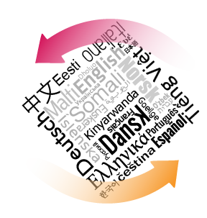


Evaluation in multilingual domain
Question: does a model perform equally well for all the languages, and how well it works when applied to a new language?
An approach that works well on several languages from different language families is considered as “truly multilingual.”
Evaluation on multiple languages must be performed.
Notes:
Question: does a model developed for a group of languages perform equally well for all the languages, and how well it works when applied to a new language?
Even if a model is intended to be multilingual, it can contain intrinsic assumptions about language structure and its statistic properties. Therefore, an approach that works well on several languages from different language families is usually thought of as “truly multilingual.” In order to make conclusions about
multilingual abilities of an approach, evaluation of its performance on multiple
languages must be performed. As we mentioned in Section 3.3, automatic evaluations
need gold standard data, and in multilingual experiment it must be provided
on each language. Also, tools for automatic evaluations must be adapted to various
languages. Human evaluations do not require neither annotated data nor tools,
but human experts with language skills are in demand. Both scenarios create a big
challenge for the low resource languages.

Slide 58

Evaluation in multilingual domain
Automatic evaluations
need gold standard data, provided on each language
tools for automatic evaluations must be adapted to various languages.
Human evaluations
human experts with language skills are in demand
Both scenarios create a big challenge for the low-resource languages.
Notes:
Question: does a model developed for a group of languages perform equally well for all the languages, and how well it works when applied to a new language?
Even if a model is intended to be multilingual, it can contain intrinsic assumptions about language structure and its statistic properties. Therefore, an approach that works well on several languages from different language families is usually thought of as “truly multilingual.” In order to make conclusions about
multilingual abilities of an approach, evaluation of its performance on multiple
languages must be performed. As we mentioned in Section 3.3, automatic evaluations
need gold standard data, and in multilingual experiment it must be provided
on each language. Also, tools for automatic evaluations must be adapted to various
languages. Human evaluations do not require neither annotated data nor tools,
but human experts with language skills are in demand. Both scenarios create a big
challenge for the low resource languages.

Slide 59
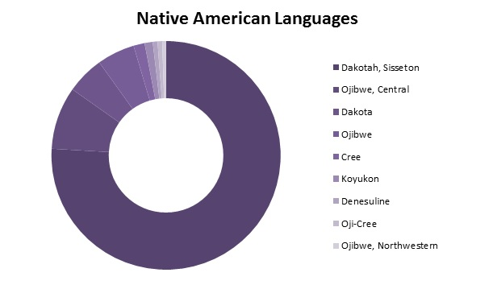
Evaluation in multilingual domain: Low resource languages
The term under-resourced languages refers to a language with at least one of the following aspects:
lack of a unique writing system,
limited presence on the web,
lack of linguistic expertise,
lack of electronic resources for speech and language processing.

Slide 60
Evaluation in multilingual domain: Low resource languages
To define the status of a language, one may use the Basic LAnguage Resource Kit (BLARK), at http://www.elsnet.org/dox/blark.html
An under-resourced language is a language that has a score below 10/20.
Even some European languages are still considered as under-resourced (Croatian, Icelandic, Latvian, Lithuanian, Maltese, and Romanian).
Hebrew is under-resourced too!

Slide 61
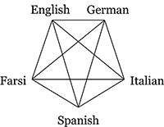
Evaluation in multilingual domain: Low resource languages
A cross-lingual training can be helpful in some cases, but usually it suffers from poor performance, due to inter-language differences.

Slide 62
Evaluation in multilingual domain: Multilingual approaches, conclusion
A multilingual approach has the following qualities:
It does not rely heavily on preprocessing tools and methods that use deep linguistic insight into a certain language, but rather on methods that are simple and available for many different languages.
It can be moved from one language to another if tools used by it are available for the new language.
It must be tested and evaluated on more than one language.

Slide 63


